Slide 1
University of Passau
6172 Immersive Analytics
Final Presentation
Group 5
Neha Beru
Divya Dhiraj

Slide 2
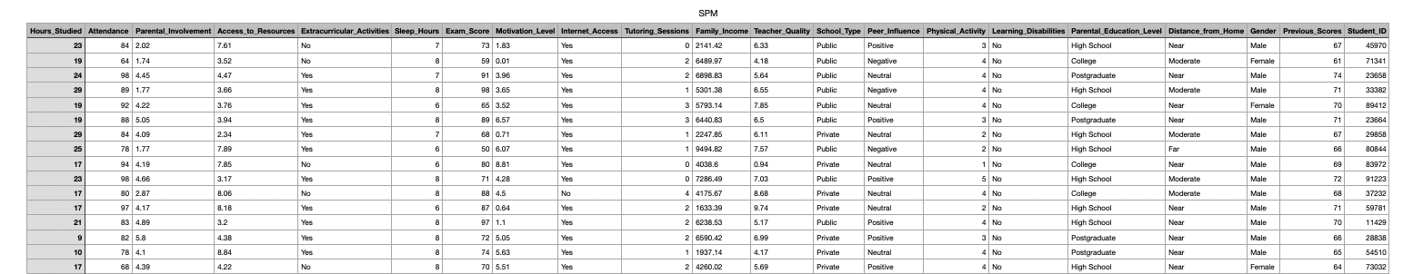
Student Performance Analytics
Project Goal: The goal of this project is to leverage 3D visualization to analyze factors affecting student performance, making it easier for educators, counselors, and administrators to understand complex relationships within the data. Immersive analytics will highlight influential factors (e.g., hours studied, sleep, family income) in an intuitive, interactive format, helping to identify patterns and inform interventions.
Dataset and Format: The dataset consists of Student Performance Factors in CSV format. The number of records are 1000 and the number of features are 21.

Slide 3
Visualization and Interaction Plan
Graph | Attributes Used | What It Represents and Interactions
Scatter Plot (Start) | Hours_Studied, Attendance, Exam_Score | Correlation between study habits and performance. -Tap on a point to see student info Showing Student Info: Student ID: 65056 Exam Score: 70 Hours Studied: 20 Motivation Level: 1.11 -Zoom and Rotate view
Scatter Plot (Start) | Hours_Studied, Attendance, Exam_Score | Correlation between study habits and performance. -Tap on a point to see student info Showing Student Info: Student ID: 65056 Exam Score: 70 Hours Studied: 20 Motivation Level: 1.11 -Zoom and Rotate view
Bar Chart | TutoringSessions, StudentCount | Number of students in different tutoring sessions -Labels
Bar Chart | TutoringSessions, StudentCount | Number of students in different tutoring sessions -Labels
Heatmap | MotivationLevel, SleepHours, ParentalInvolvement | Patterns of motivation and sleep habits. -Labels -Rotate
Heatmap | MotivationLevel, SleepHours, ParentalInvolvement | Patterns of motivation and sleep habits. -Labels -Rotate
Network Graph | Student Connections, Peer Influence, TutoringGroups | Social and academic relationships between students
Network Graph | Student Connections, Peer Influence, TutoringGroups | Social and academic relationships between students
Parallel Coordinates | HoursStudied, ExamScore, ParentalInvolvement | Comparison of multiple student attributes over a dataset
Parallel Coordinates | HoursStudied, ExamScore, ParentalInvolvement | Comparison of multiple student attributes over a dataset

Slide 4
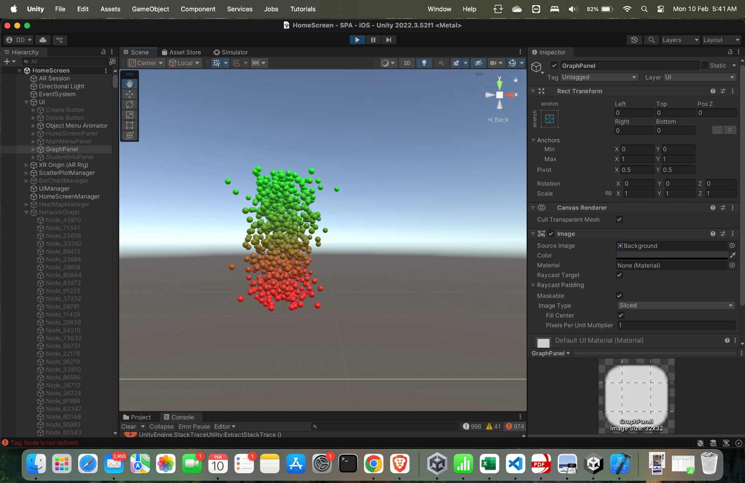

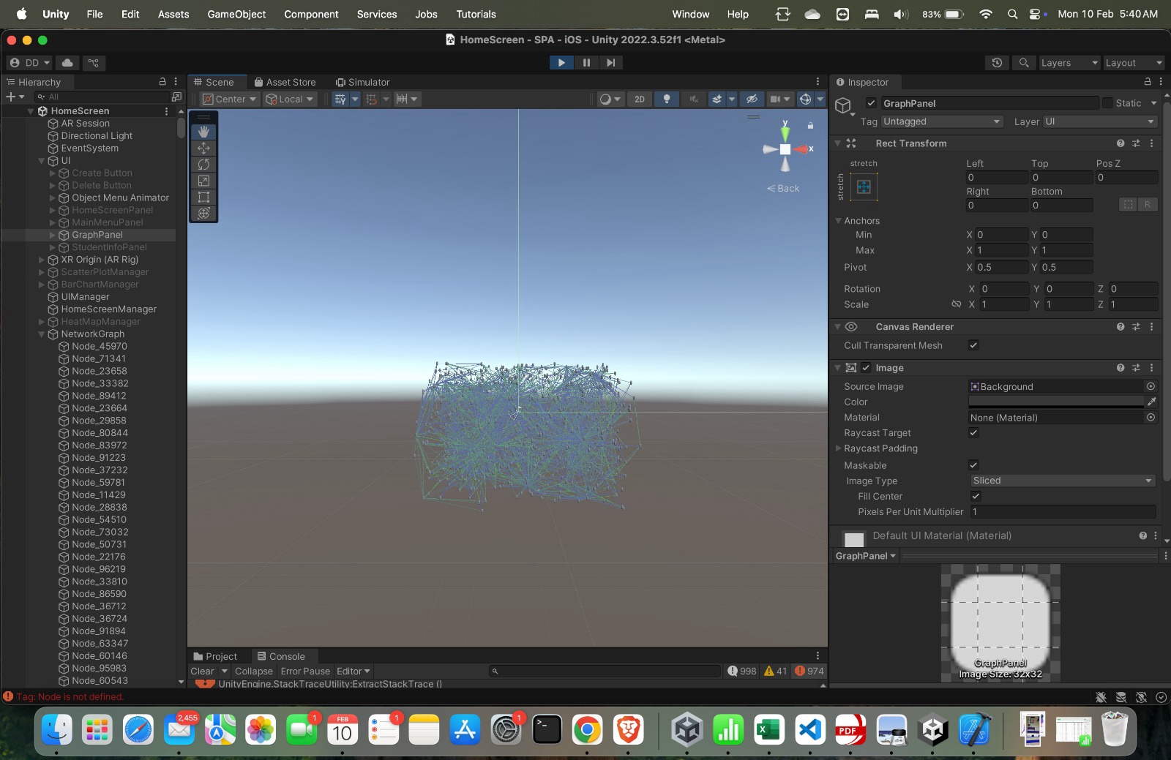
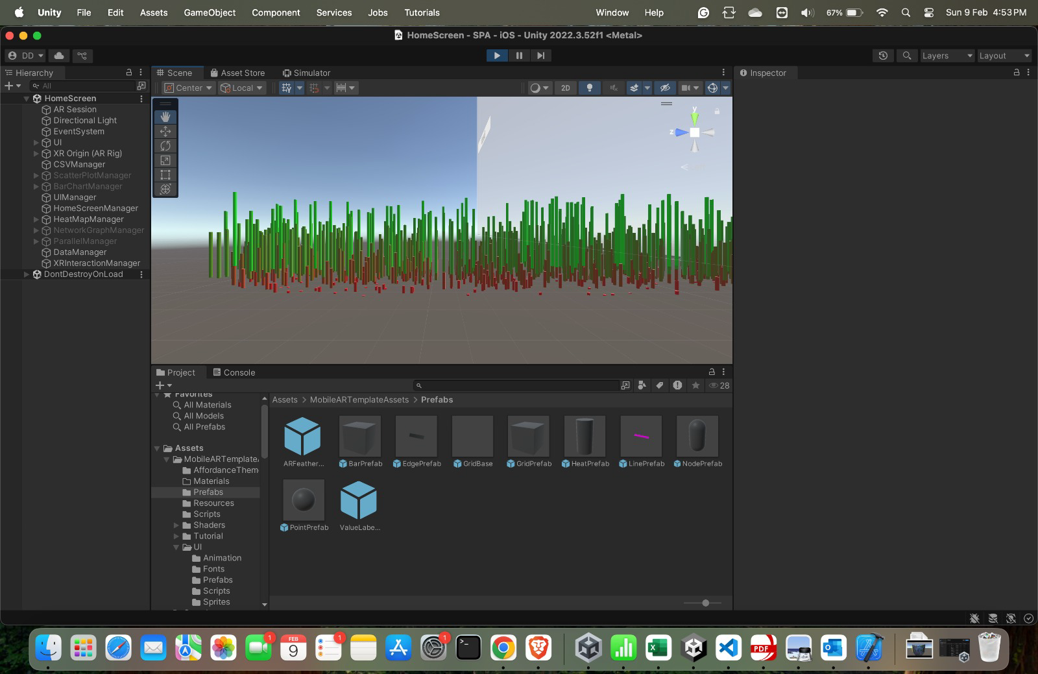
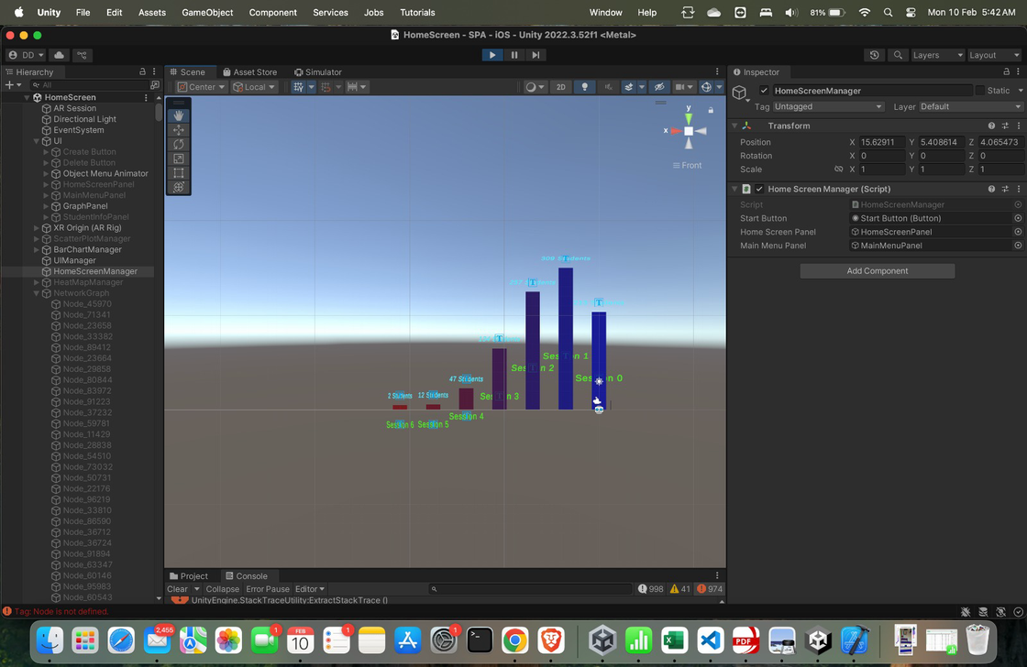
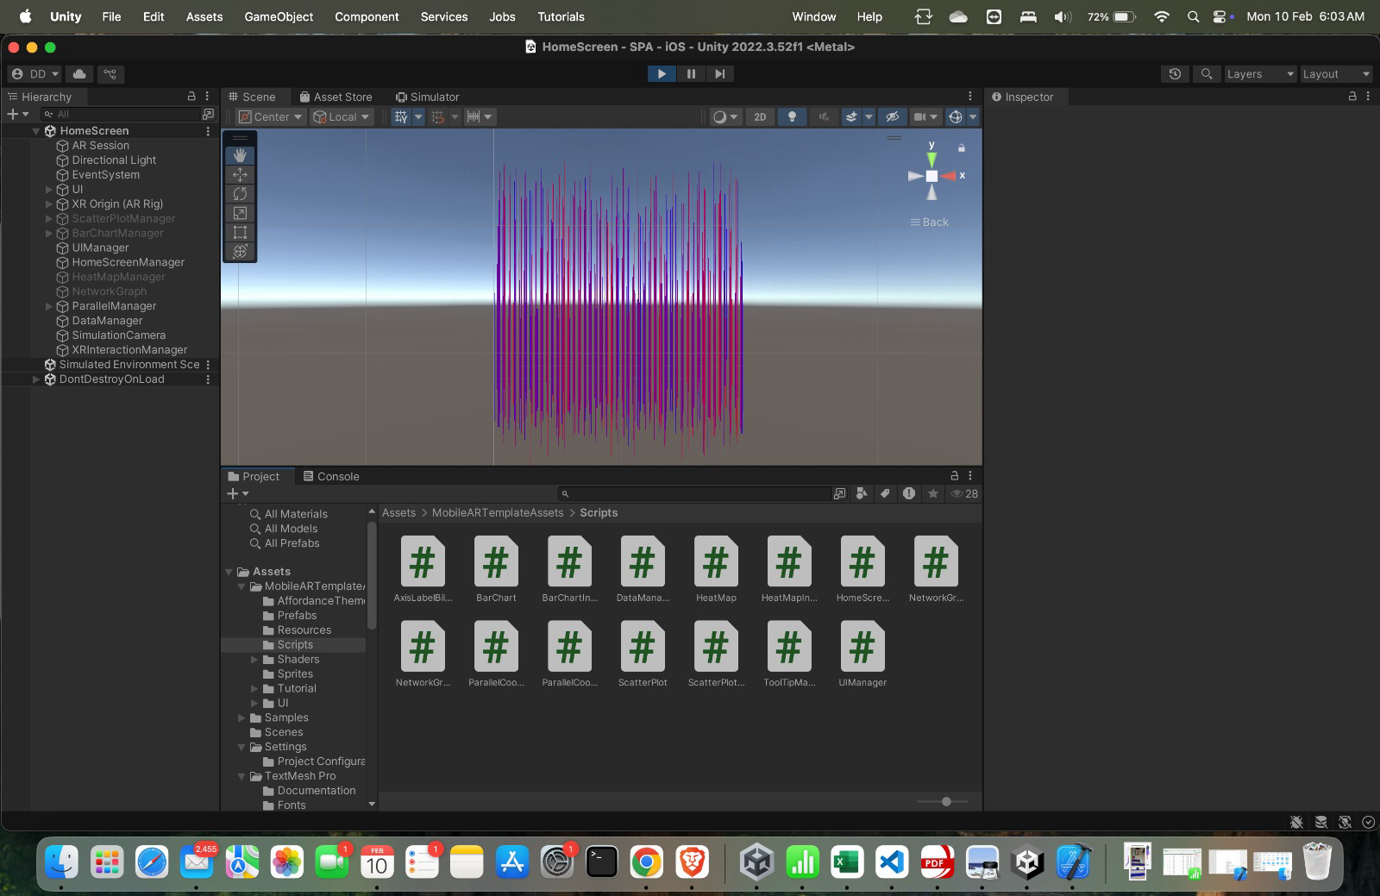
3D Visualizations

Slide 5
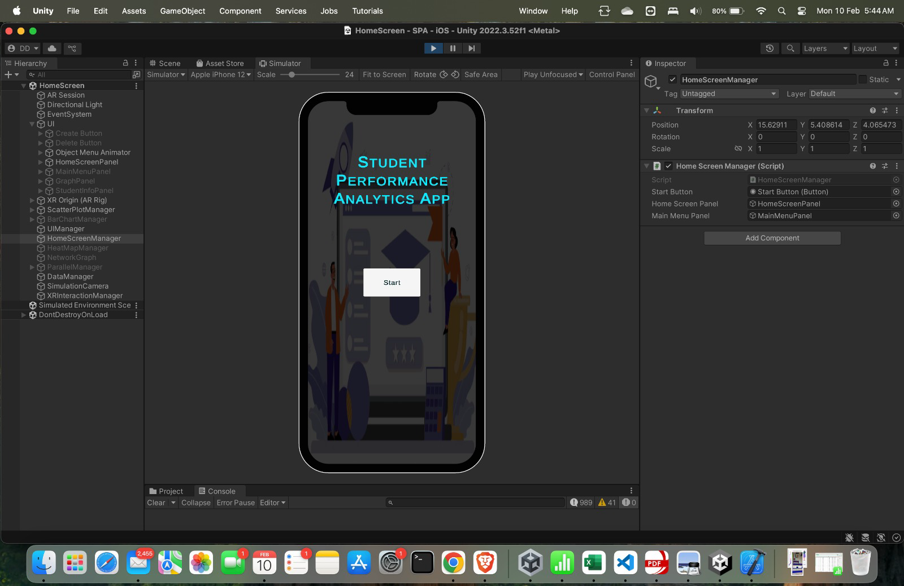
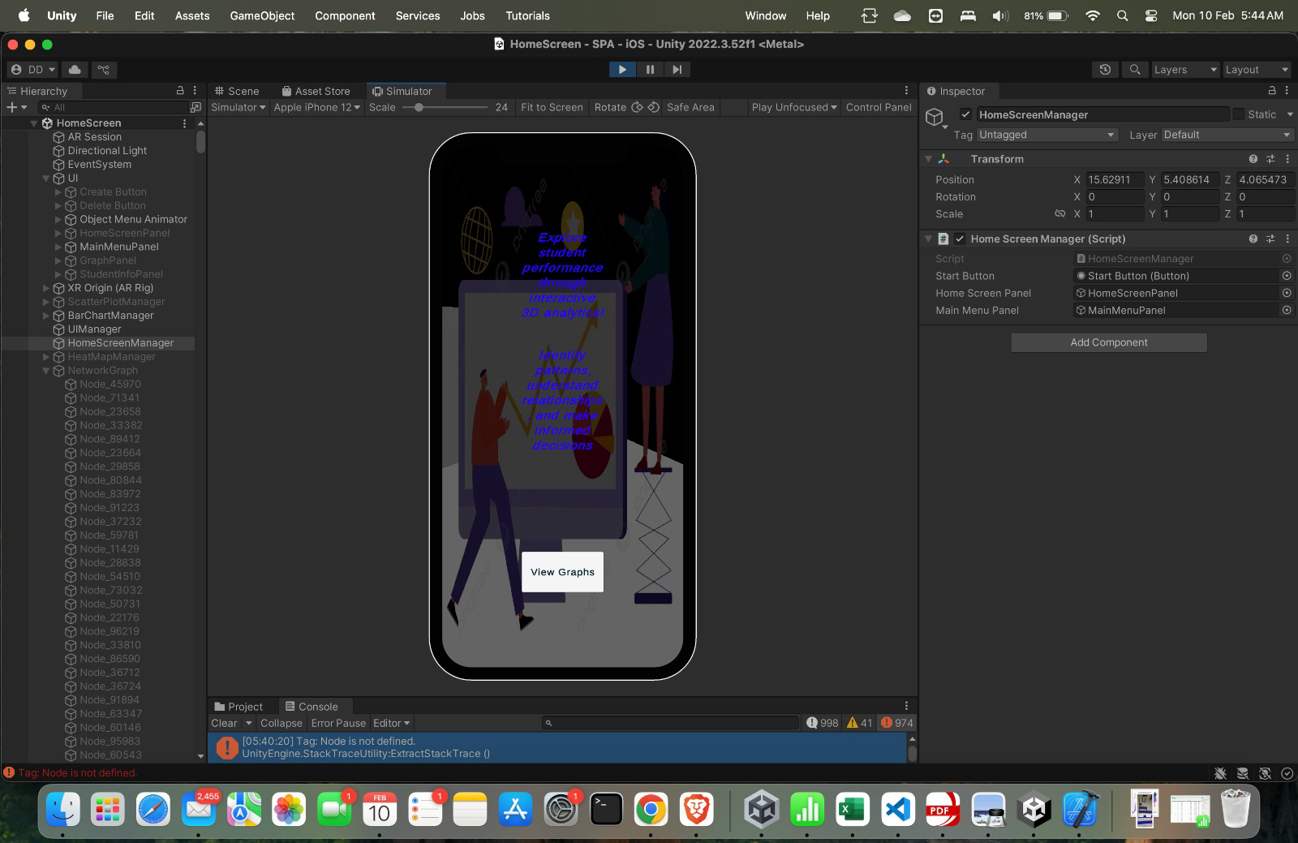
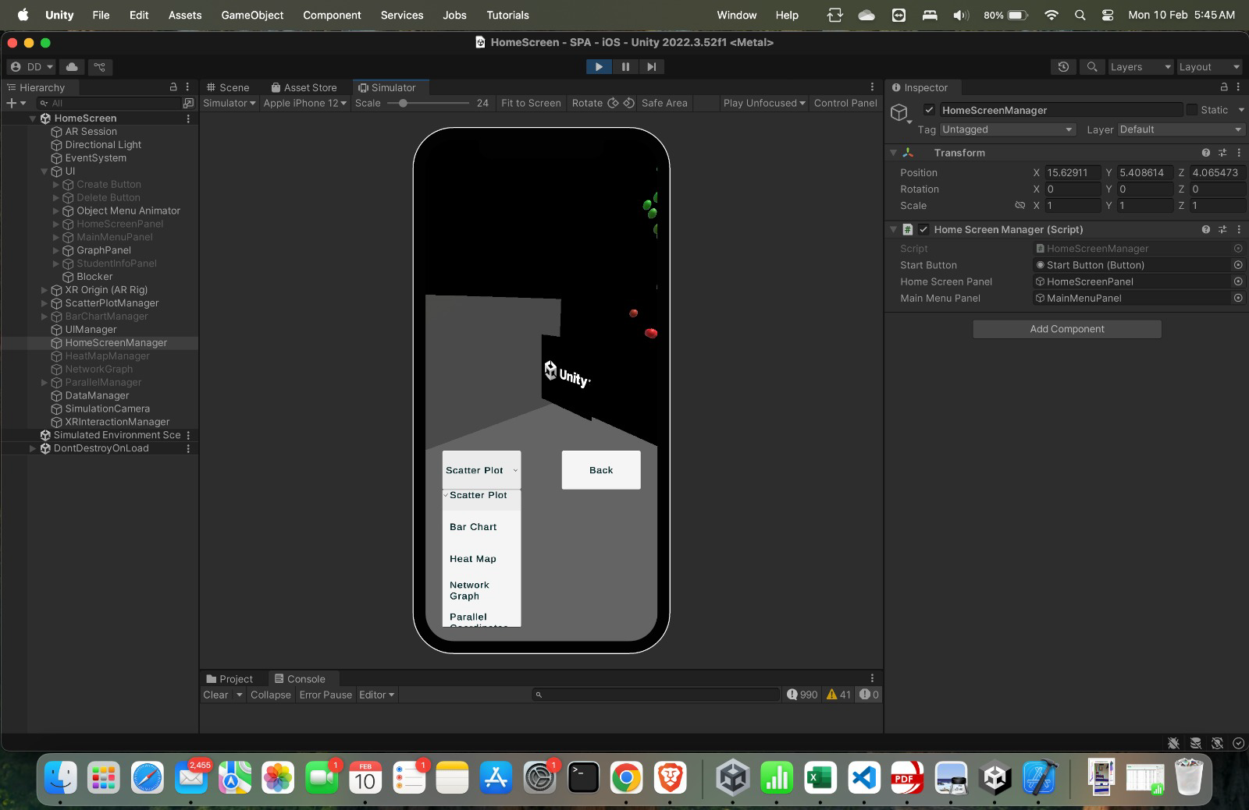
UI

Slide 6
Code Review

Slide 7
Thank You

